Slide 1


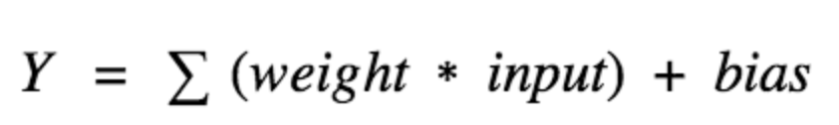
Input Layer (Experimentally determined)
Hidden Layer 1
(Transformation of input data)
Output Layer (What our network should predict)
Hidden Layer 2
(Transformation 2)
Node 1
Sequence Residue
Configuration of secondary structure: Percent (%) alpha-helix, beta, and random coil.
…
…
Node m
CD Basis Spectra
Each node in the hidden layer is governed by this equation and uses an activation function which introduces non-linearity to the network. A weight represents a strength of connection between units and a bias of 1 is used as an offset in case of any 0’s in input values.
What I am using as input

Slide 2
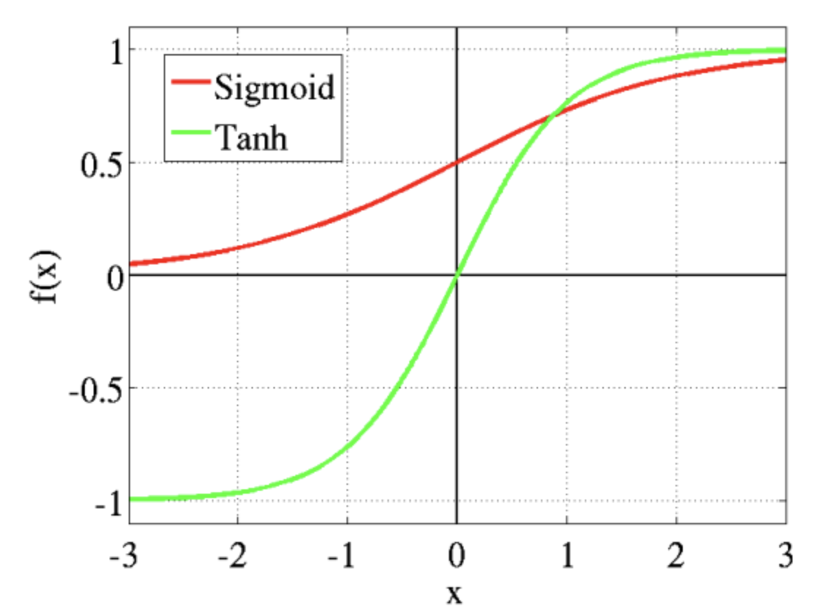
Activation Functions
Activation functions:
Used to create non-linearity to the network
Eg. sigmoid function maps values from -1 to 1 while hyperbolic tangent functions maps from 0 to 1
Sigmoid is typically used to predict probability
Allows for back-propagation (updating weights and biases based on error of the output)

